Slide 1
Sequence and Collaboration Diagrams

Slide 2
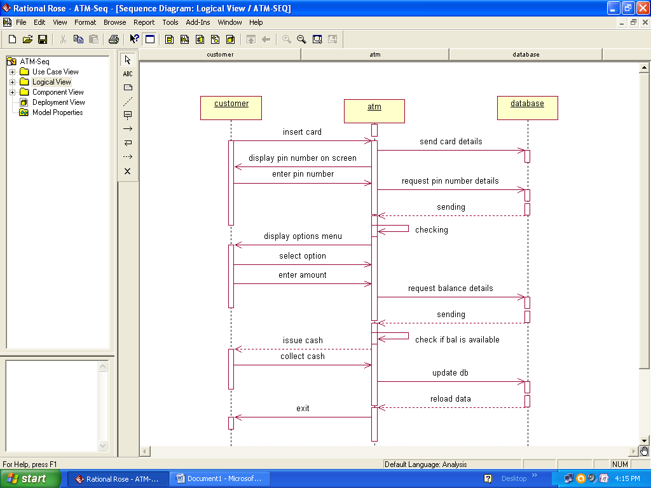
ATM-Seq

Slide 3
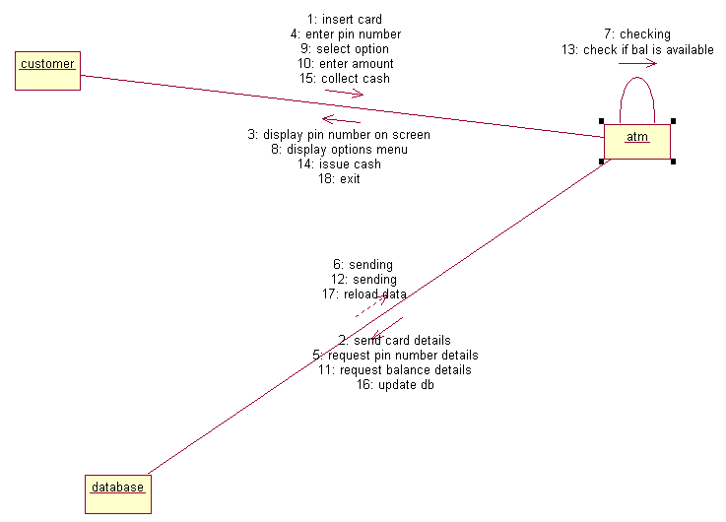

Slide 4
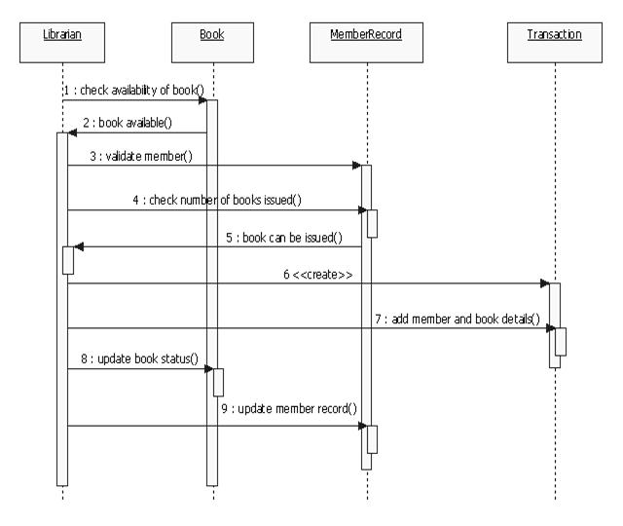
Library Mgmt Sys-Issuing Book-Seqdia

Slide 5
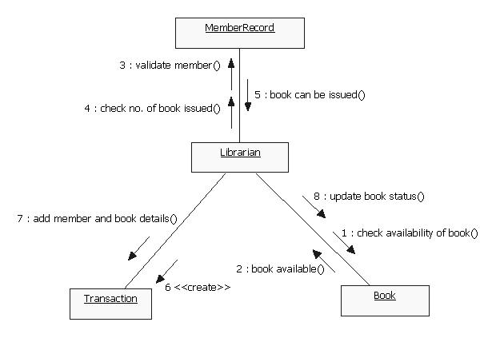

Slide 6
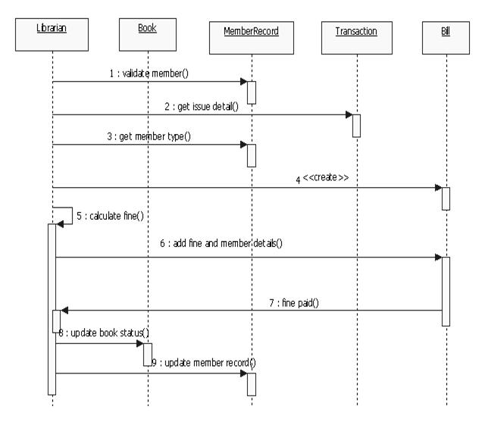
Library Mgmt Sys-Returning Book-Seqdia

Slide 7
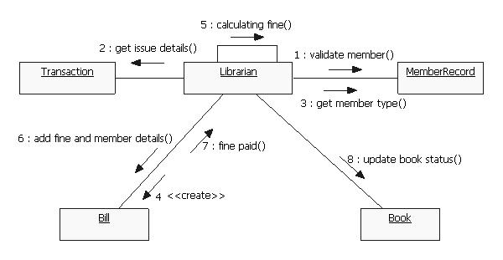

Slide 8
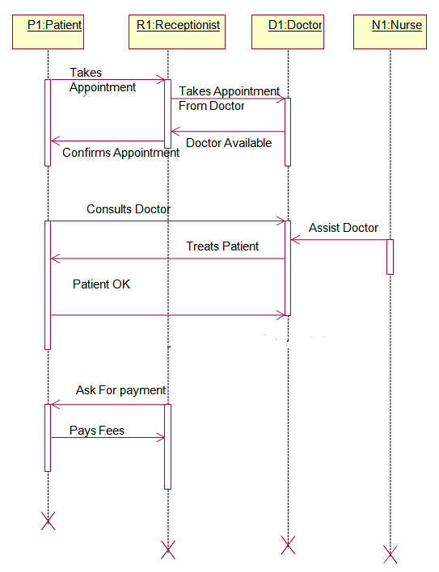
HMS-Seq Dia

Slide 9
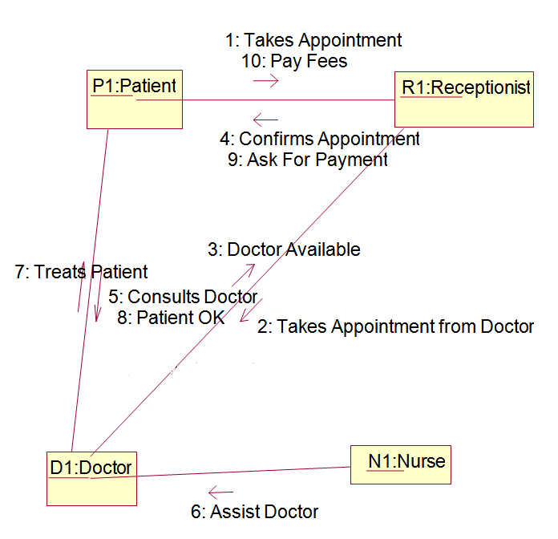
HMS-Collaboration Dia

Slide 10
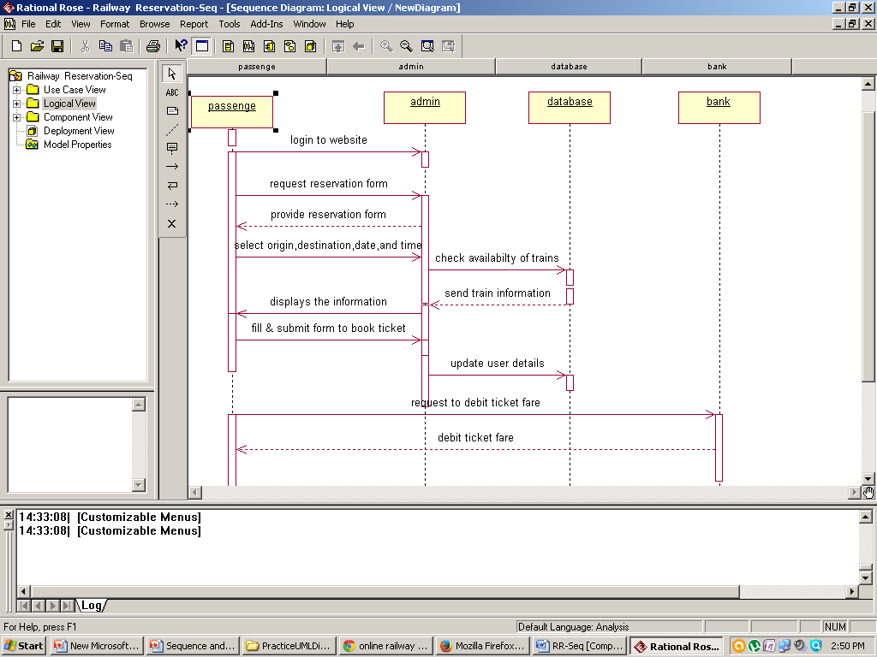
Railway Reservation Seq Dia

Slide 11
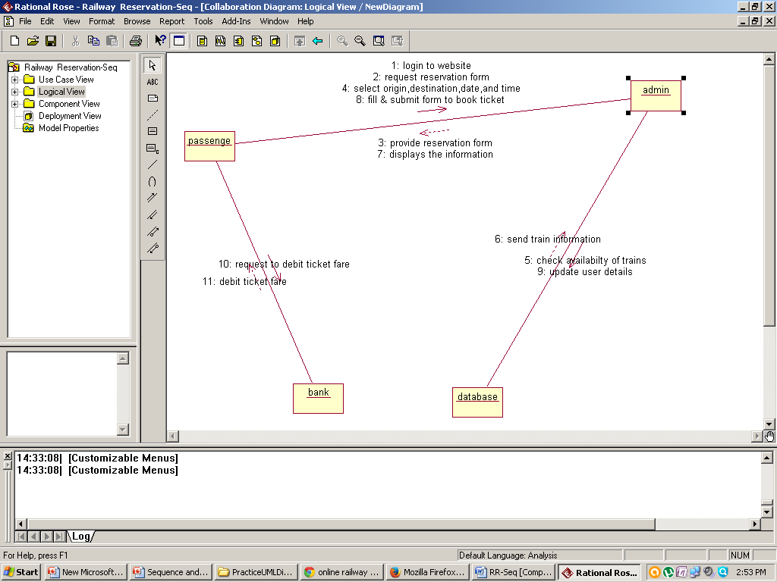
Railway Reservation Coll. Dia

